Slide 1







CS 110 Project: “Meme” Spring 2021
Ibrahim Gohar / Rana Elgahawy
Abdelaaty Rehab / Ghada Amer

Slide 2
Project Description
Meme is an application that manages all aspects of personal trips including reserving flights, hotels, and cruises. It offers the user an interface that allows him to reserve the intended flight/ hotel/ cruise according to filters such as cheapest, shortest distance, specific price range. The user can get the results by searching by name or city.

Slide 3
UML
https://app.genmymodel.com/api/projects/_BBXrsI__EeuPNLbtyXZyHA/diagrams/_BBYSwo__EeuPNLbtyXZyHA/svg

Slide 4
Design Understanding – Data Structure
Data Structure | Location/ Usage/ Rational
Linked List | We specifically used it in Hotels and Rooms classes to allow us add/ delete items and not to take so much memory.
Vector | We successfully used it in available hotels/available cruise classes to allow us change its size as the available hotels/cruises increases and decreases.
Array | We specifically used it in the graph class to include the cities which are fixed number of 5.
Adjacency Matrix | We used it successfully in Reservation class to search by price range.
Name (Newly defined) | We created it specifically to use it in customer profile class to get the first and last name of the user.

Slide 5
Design Understanding- Algorithms
• Dijkstra: Shortest Path
1) Create a set sptSet (shortest path tree set) that keeps track of vertices included in shortest path tree, i.e., whose minimum distance from source is calculated and finalized. Initially, this set is empty.
2) Assign a distance value to all vertices in the input graph. Initialize all distance values as INFINITE. Assign distance value as 0 for the source vertex so that it is picked first.
3) While sptSet doesn’t include all vertices
a) Pick a vertex u which is not there in sptSet and has minimum distance value.
b) Include u to sptSet.
c) Update distance value of all adjacent vertices of u. To update the distance values, iterate through all adjacent vertices. For every adjacent vertex v, if sum of distance value of u (from source) and weight of edge u-v, is less than the distance value of v, then update the distance value of v.

Slide 6
Implementation Overview
•Database: SQL Light •Validation: Email format & only one account holder.
•Exceptions: Handler (message ) when the user use another format other than email format.

Slide 7
Bonus and Extra Functionality
Cruise
Database
Email verification
Splash screen
GUI

Slide 8

Roles of Each Member of the Group
Rana
Ibrahim
Abdelaaty
Ghada
Hotels
Rooms
Aminities
Database
Dijkstra
Promo Video
GUI
Cruise
Customer Profile/User
UML
Payment
Ticket

Slide 9
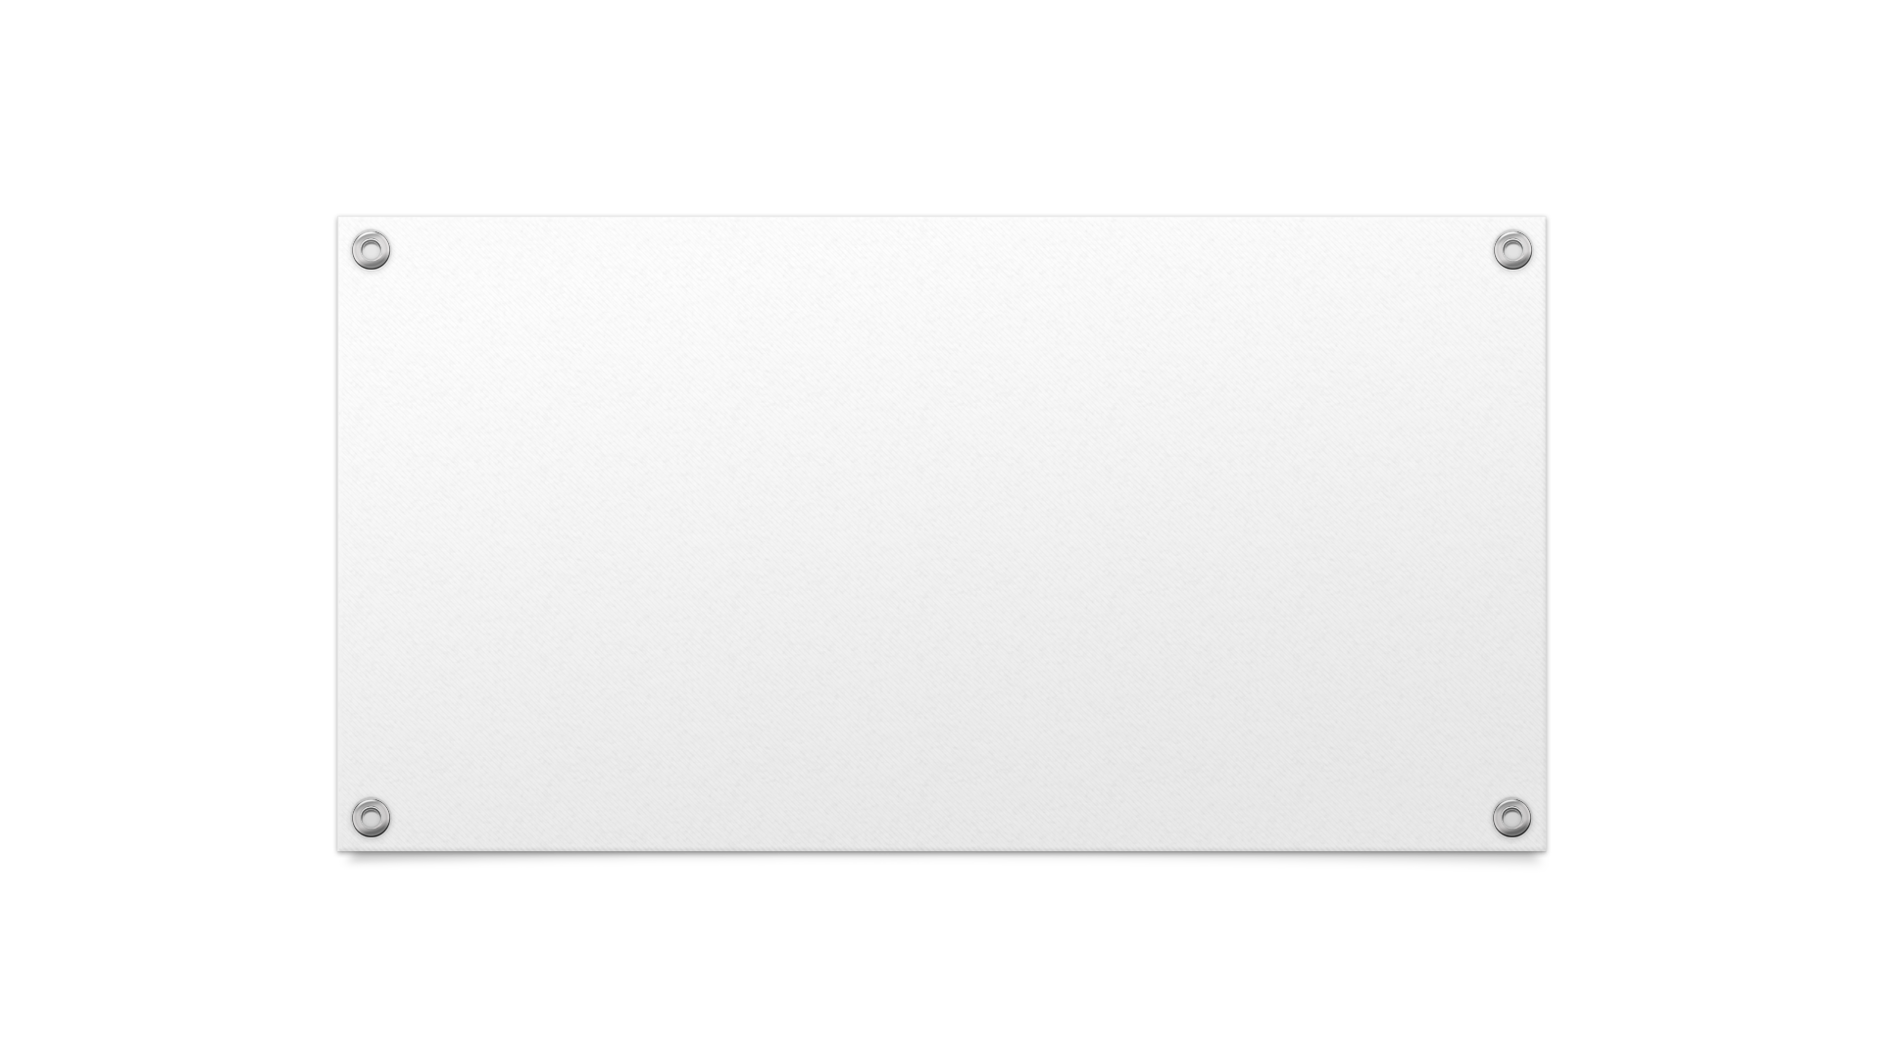

DEMO

